Slide 1
Fed-Campus Meeting Slides
Jingheng Huan

Slide 2
What I have done (Android App)
Update the Login page and remove some redundant cast
Update the implementation of dependencies in build.gradle(app) to be the newest version
Upgrade build.gradle version from 3.6.4 to 7.4.2
Added the permission of ACCESS_FINE_LOCATION and ACCESS_COARSE_LOCATION in AndroidManifest.xml
Replaced jcenter() with mavenCentral() in dependencies of build.gradle
Converted fields to local variables in HealthKitAuthActivity.java

Slide 3
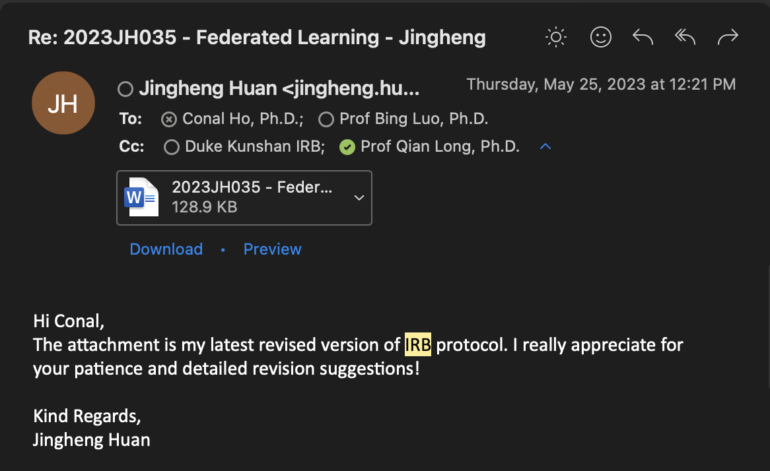
What I have done (IRB)

Slide 4
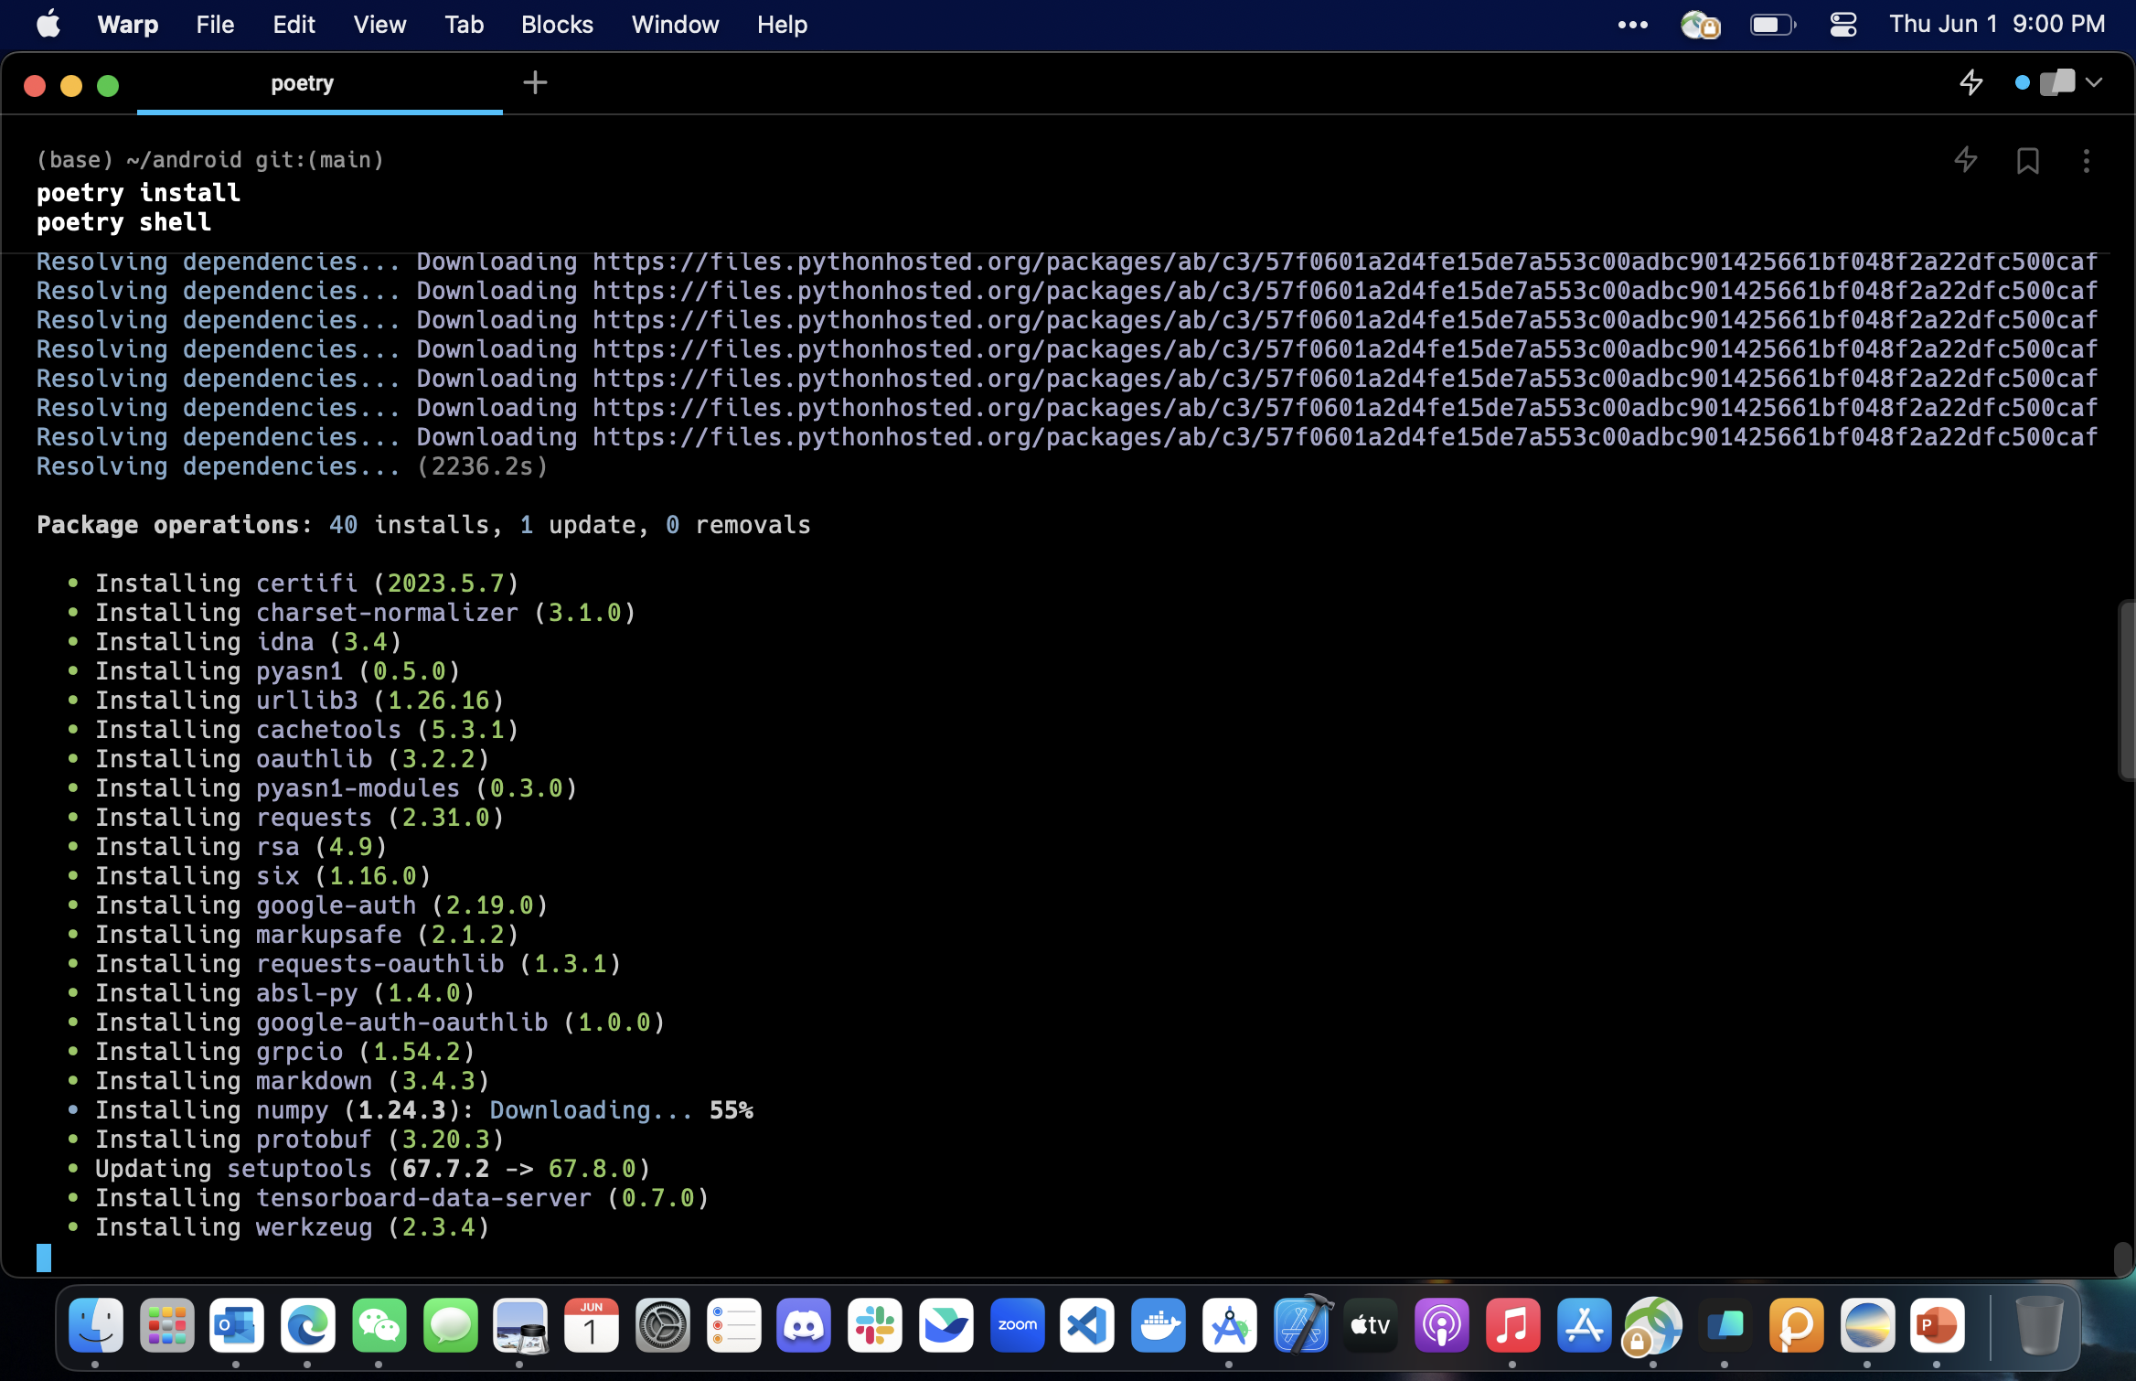
What I have done (Flower)
Set up Dynamic Flower model use on Android by wrapping Flower with Django REST Framework

Slide 5
What I have done (Flower)
This example demonstrates a federated learning setup with Android Clients.
The training on Android is done on a CIFAR10 dataset using TensorFlow Lite. The CIFAR10 dataset is randomly split across 10 clients. Each Android client holds a local dataset of 5000 training examples and 1000 test examples.
The FL server runs in Python but all the clients run on Android.
We use a strategy called FedAvgAndroid for this example.
The strategy is vanilla FedAvg with a custom serialization and deserialization to handle the Bytebuffers sent from Android clients to Python server.

Slide 6
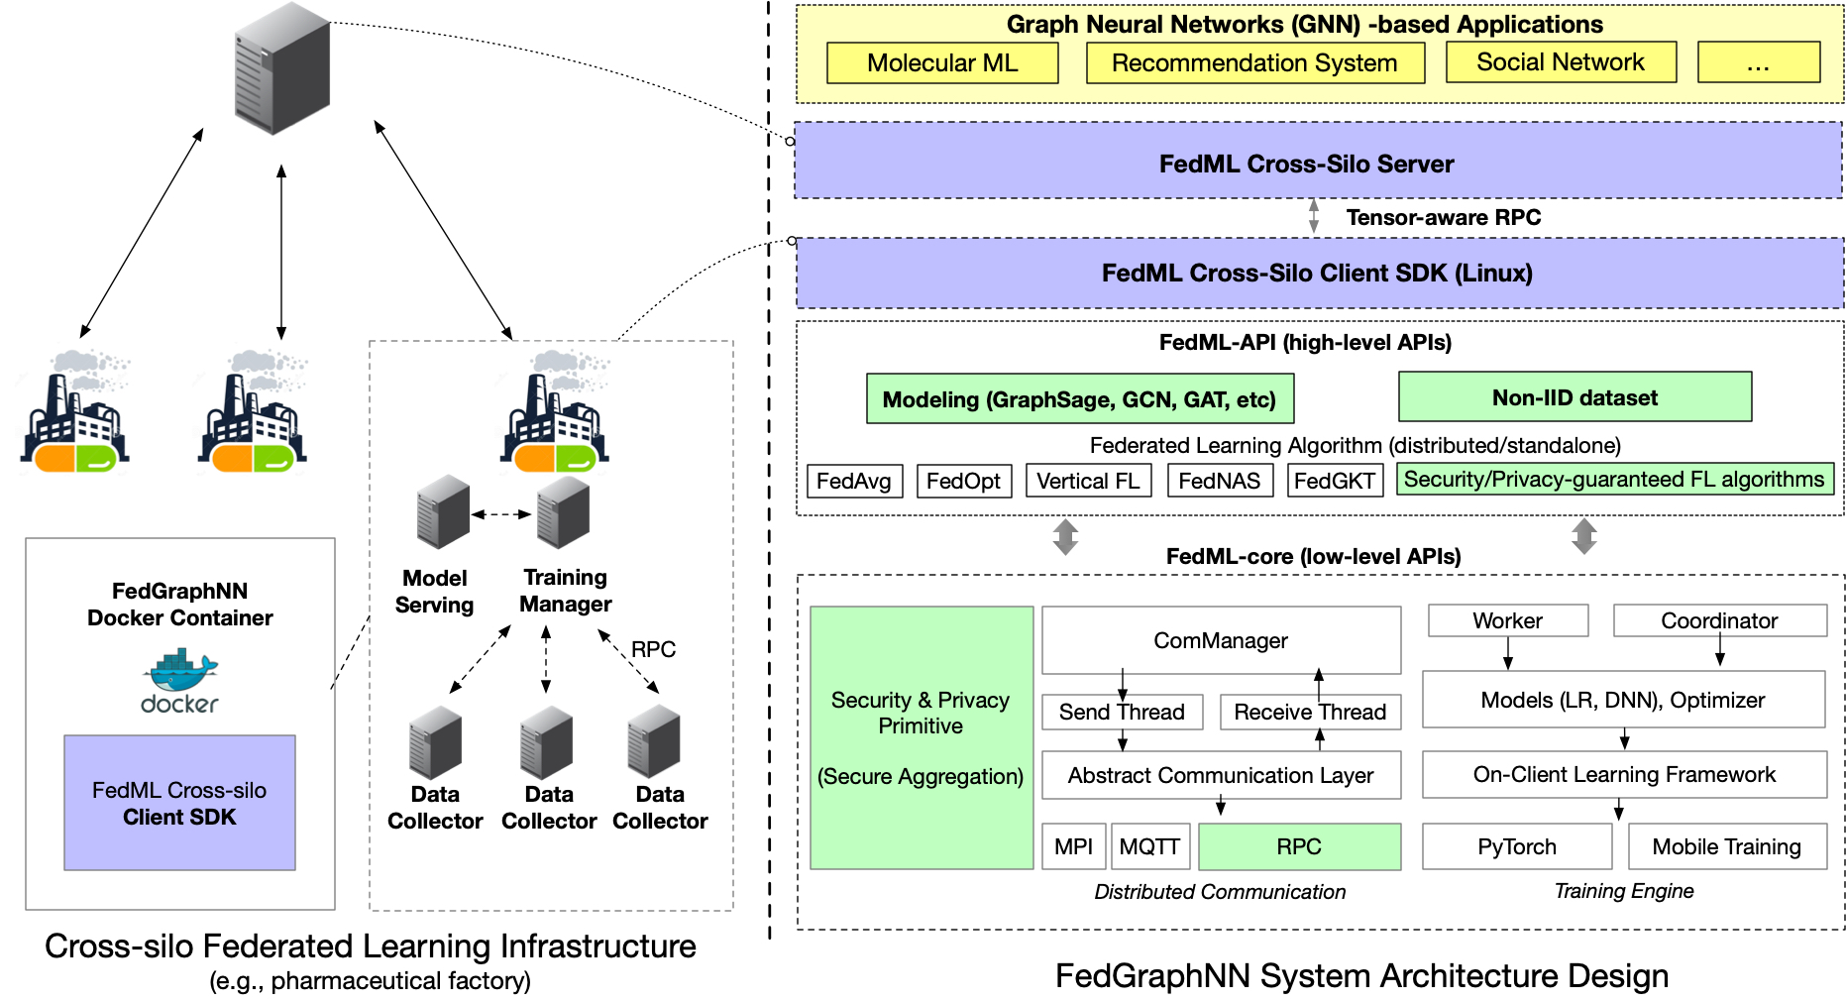
What I have done
What I have done: FedML
FedGraphNN
Graph classification

Slide 7
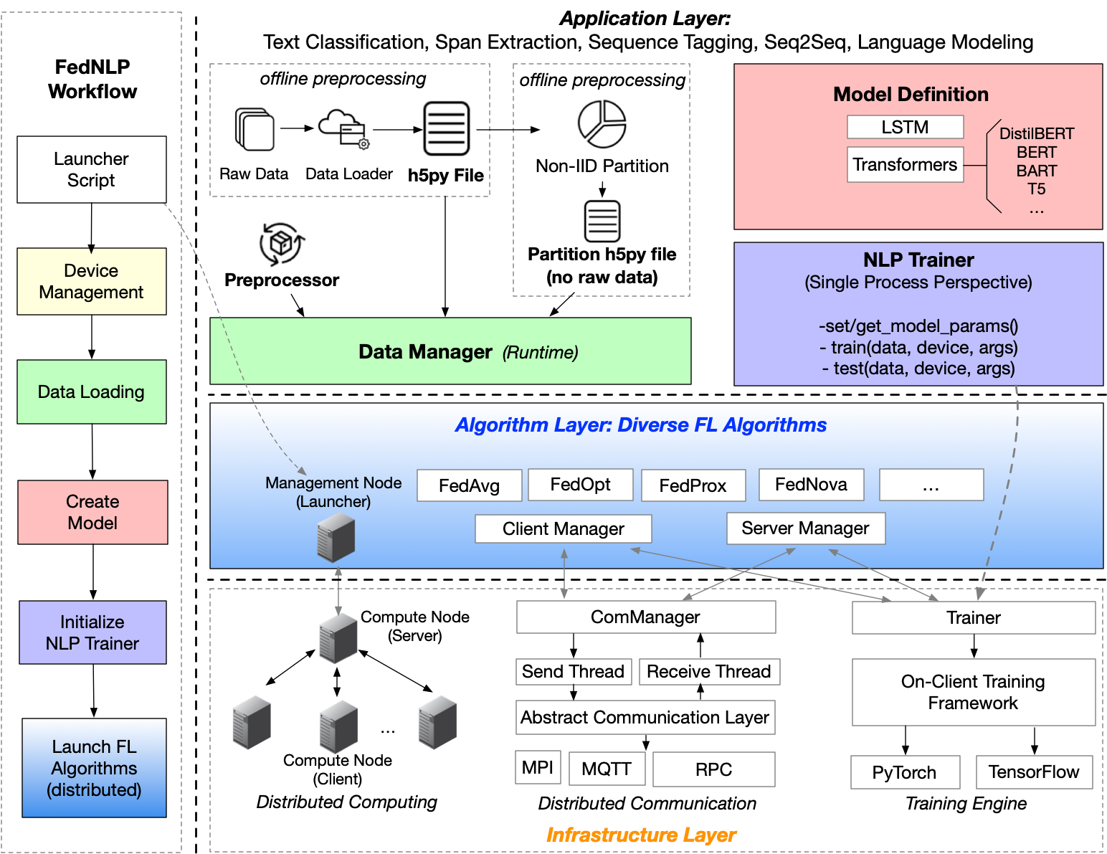
What I have done: FedML
FedNLP
TEXT CLASSIFICATION
SEQ TAGGING
SPAN EXTRACTION
SEQ2SEQ

Slide 8
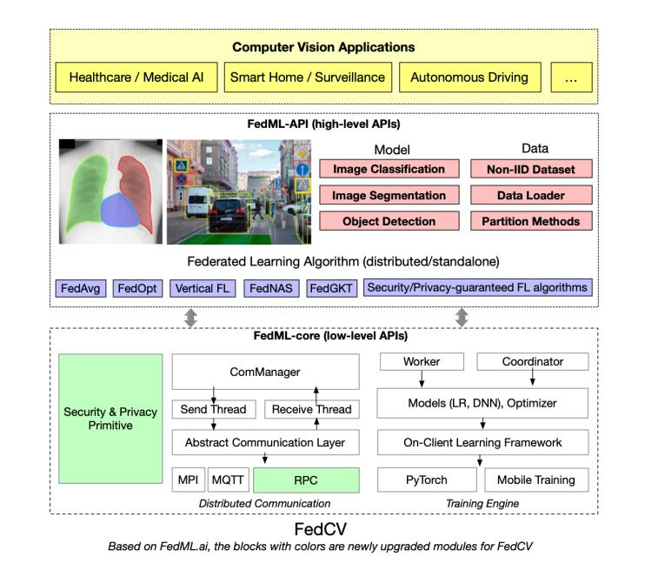
What I have done: FedML
What I have done
FedCV
Run the MPI simulation
Run the server and client using MQTT
Run the application using MLOps

Slide 9
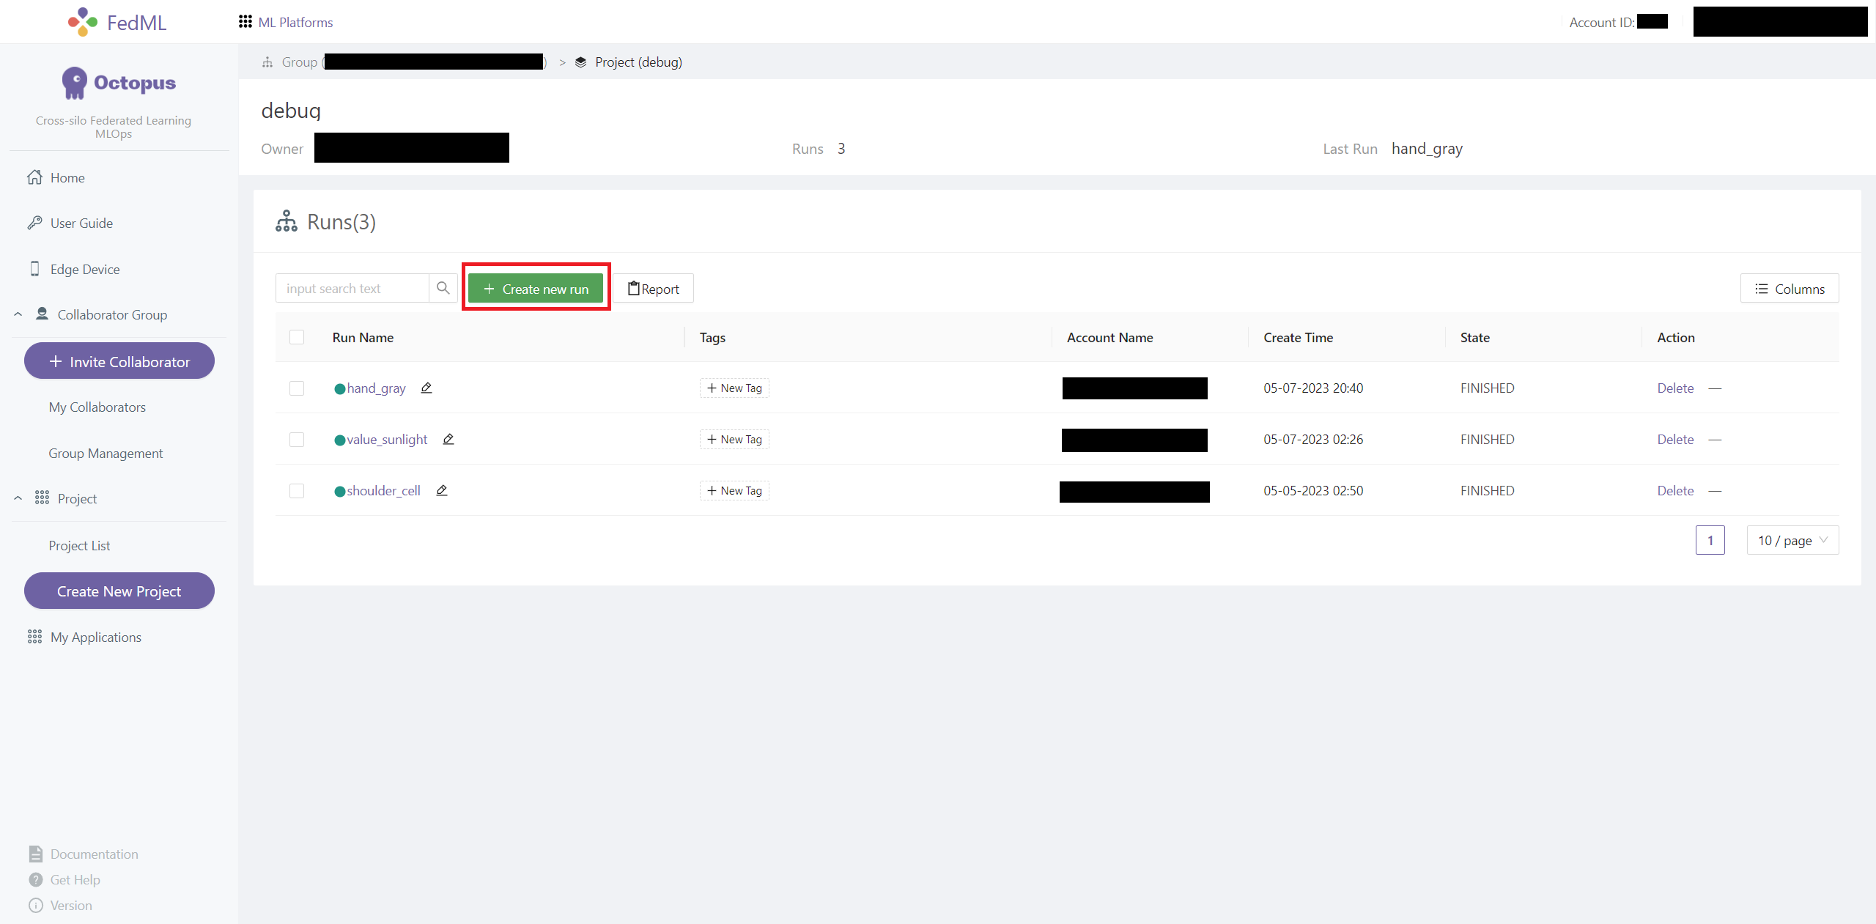
What I have done: FedML
FedLLM
Octopus
Conventional/Centralized Training
Cross-silo Federated Learning
Use (MLOps) for Model Training

Slide 10
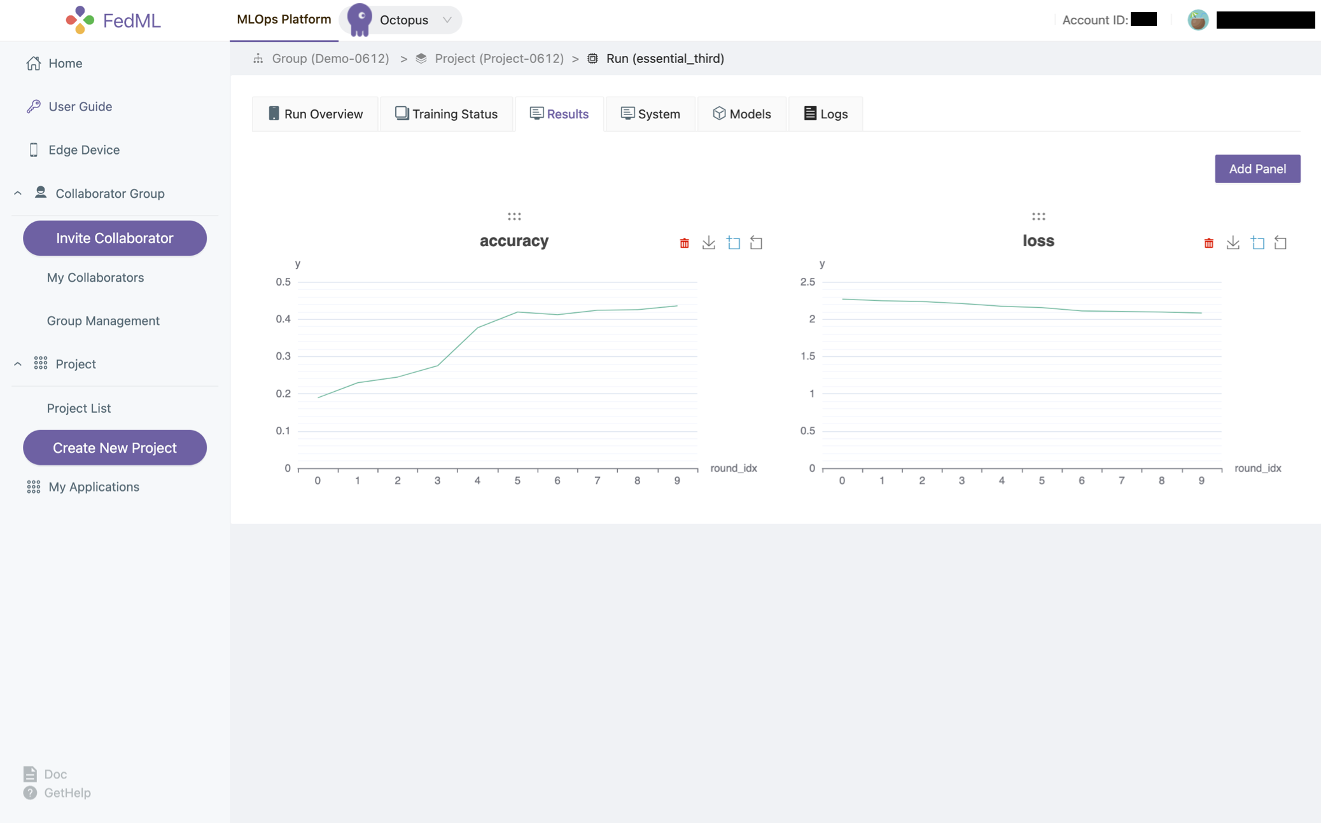
What I have done: FedML
FedLLM

Slide 11
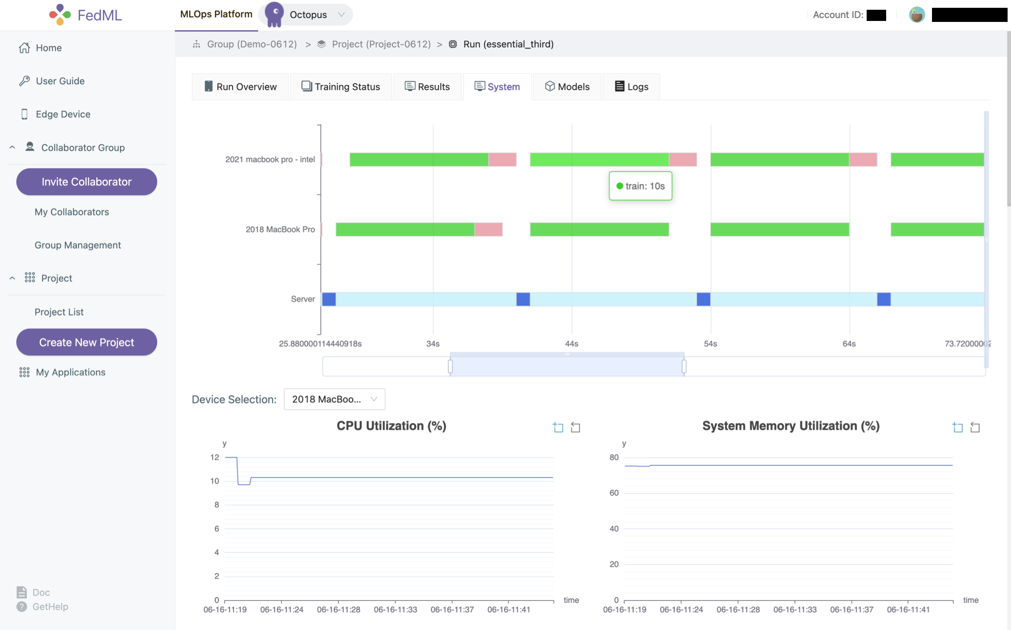
What I have done: FedML
FedLLM

Slide 12
What I have done: FedML
Install FedML with pip
Install MPI using conda (mpi4py openmpi)

Slide 13
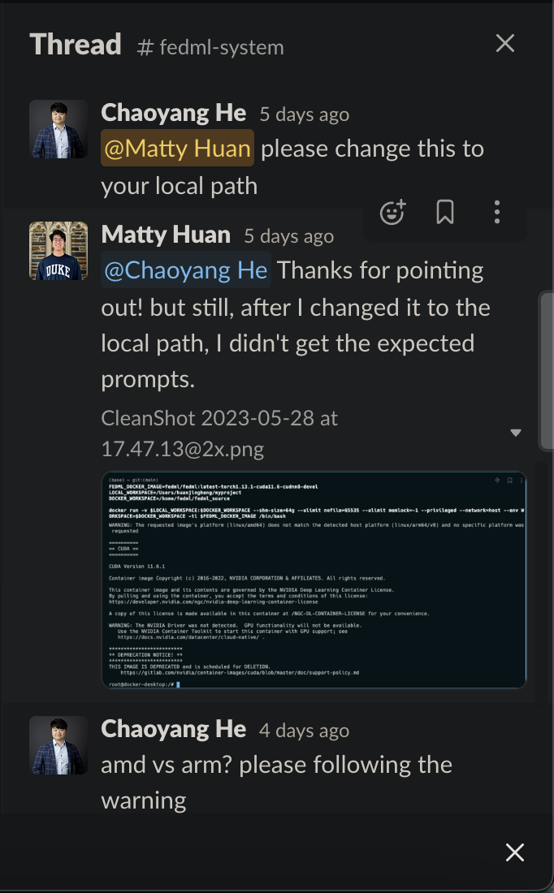
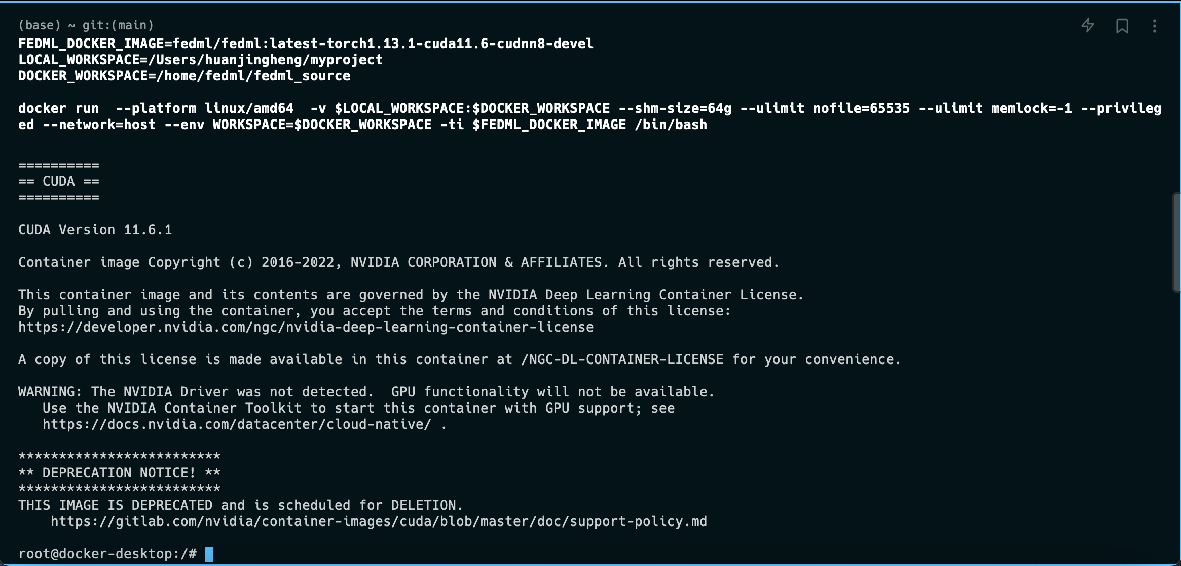
Difficulties that I have
FedML
Docker Setup (Slack with Chaoyang)

Slide 14
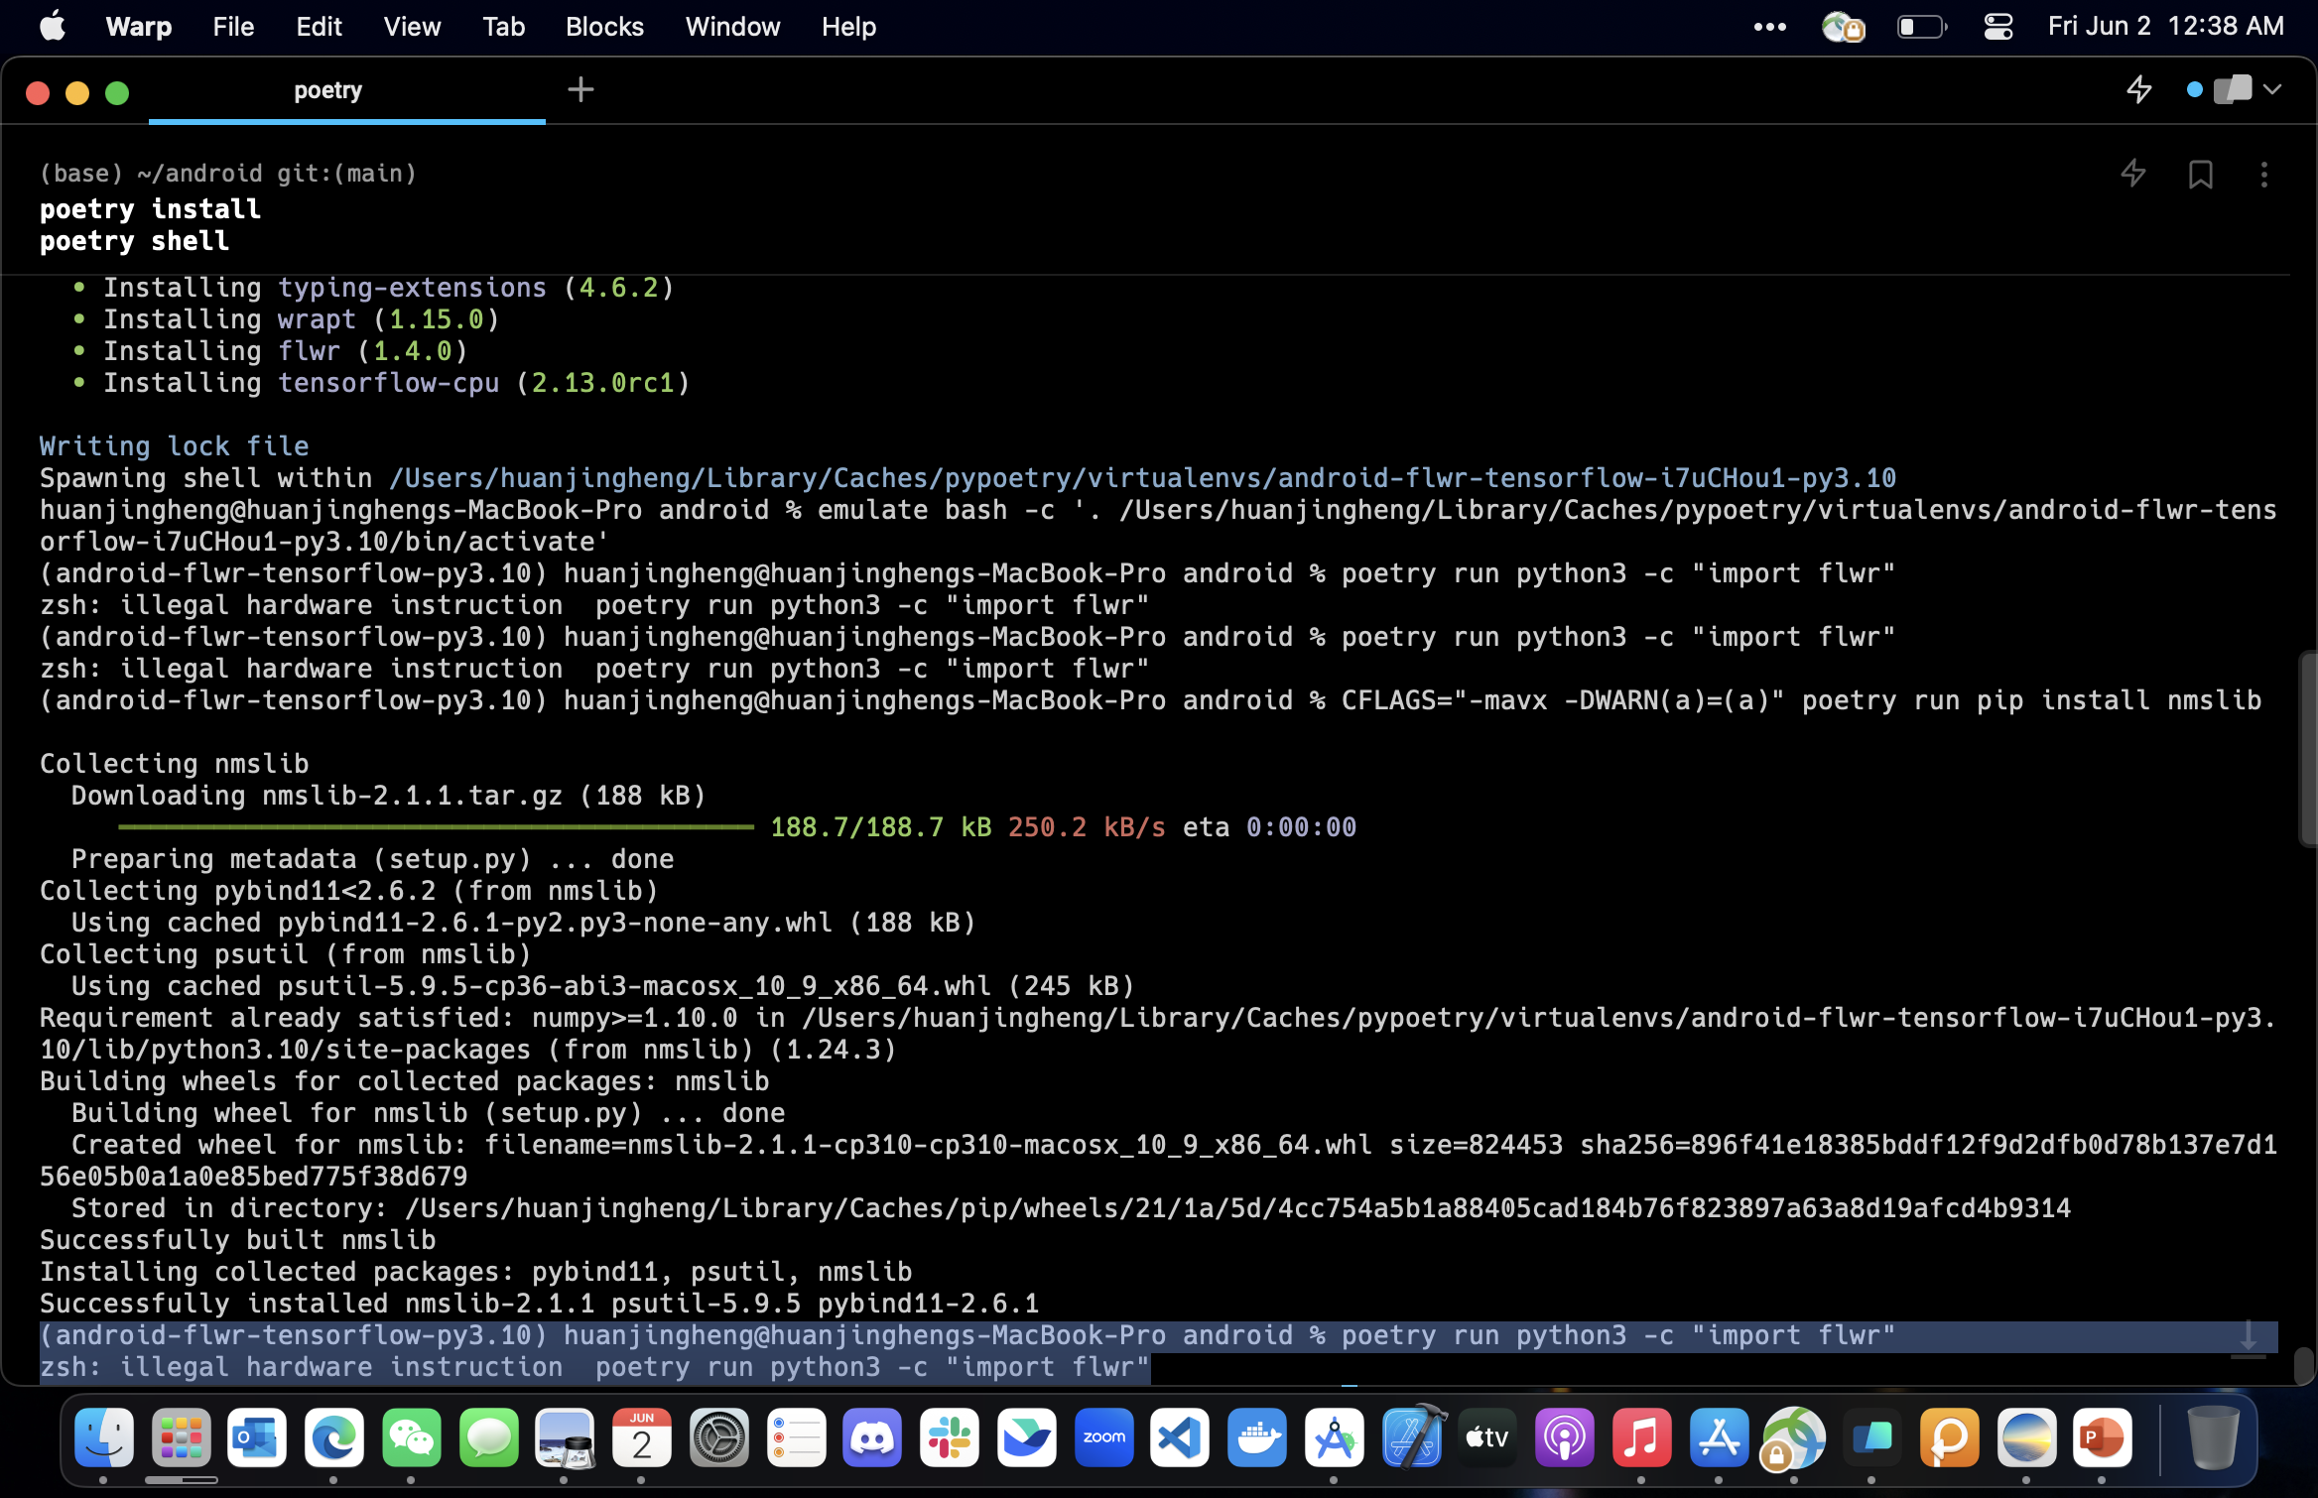
Difficulties that I have
Flower
Set up flower model (Steven)

Slide 15
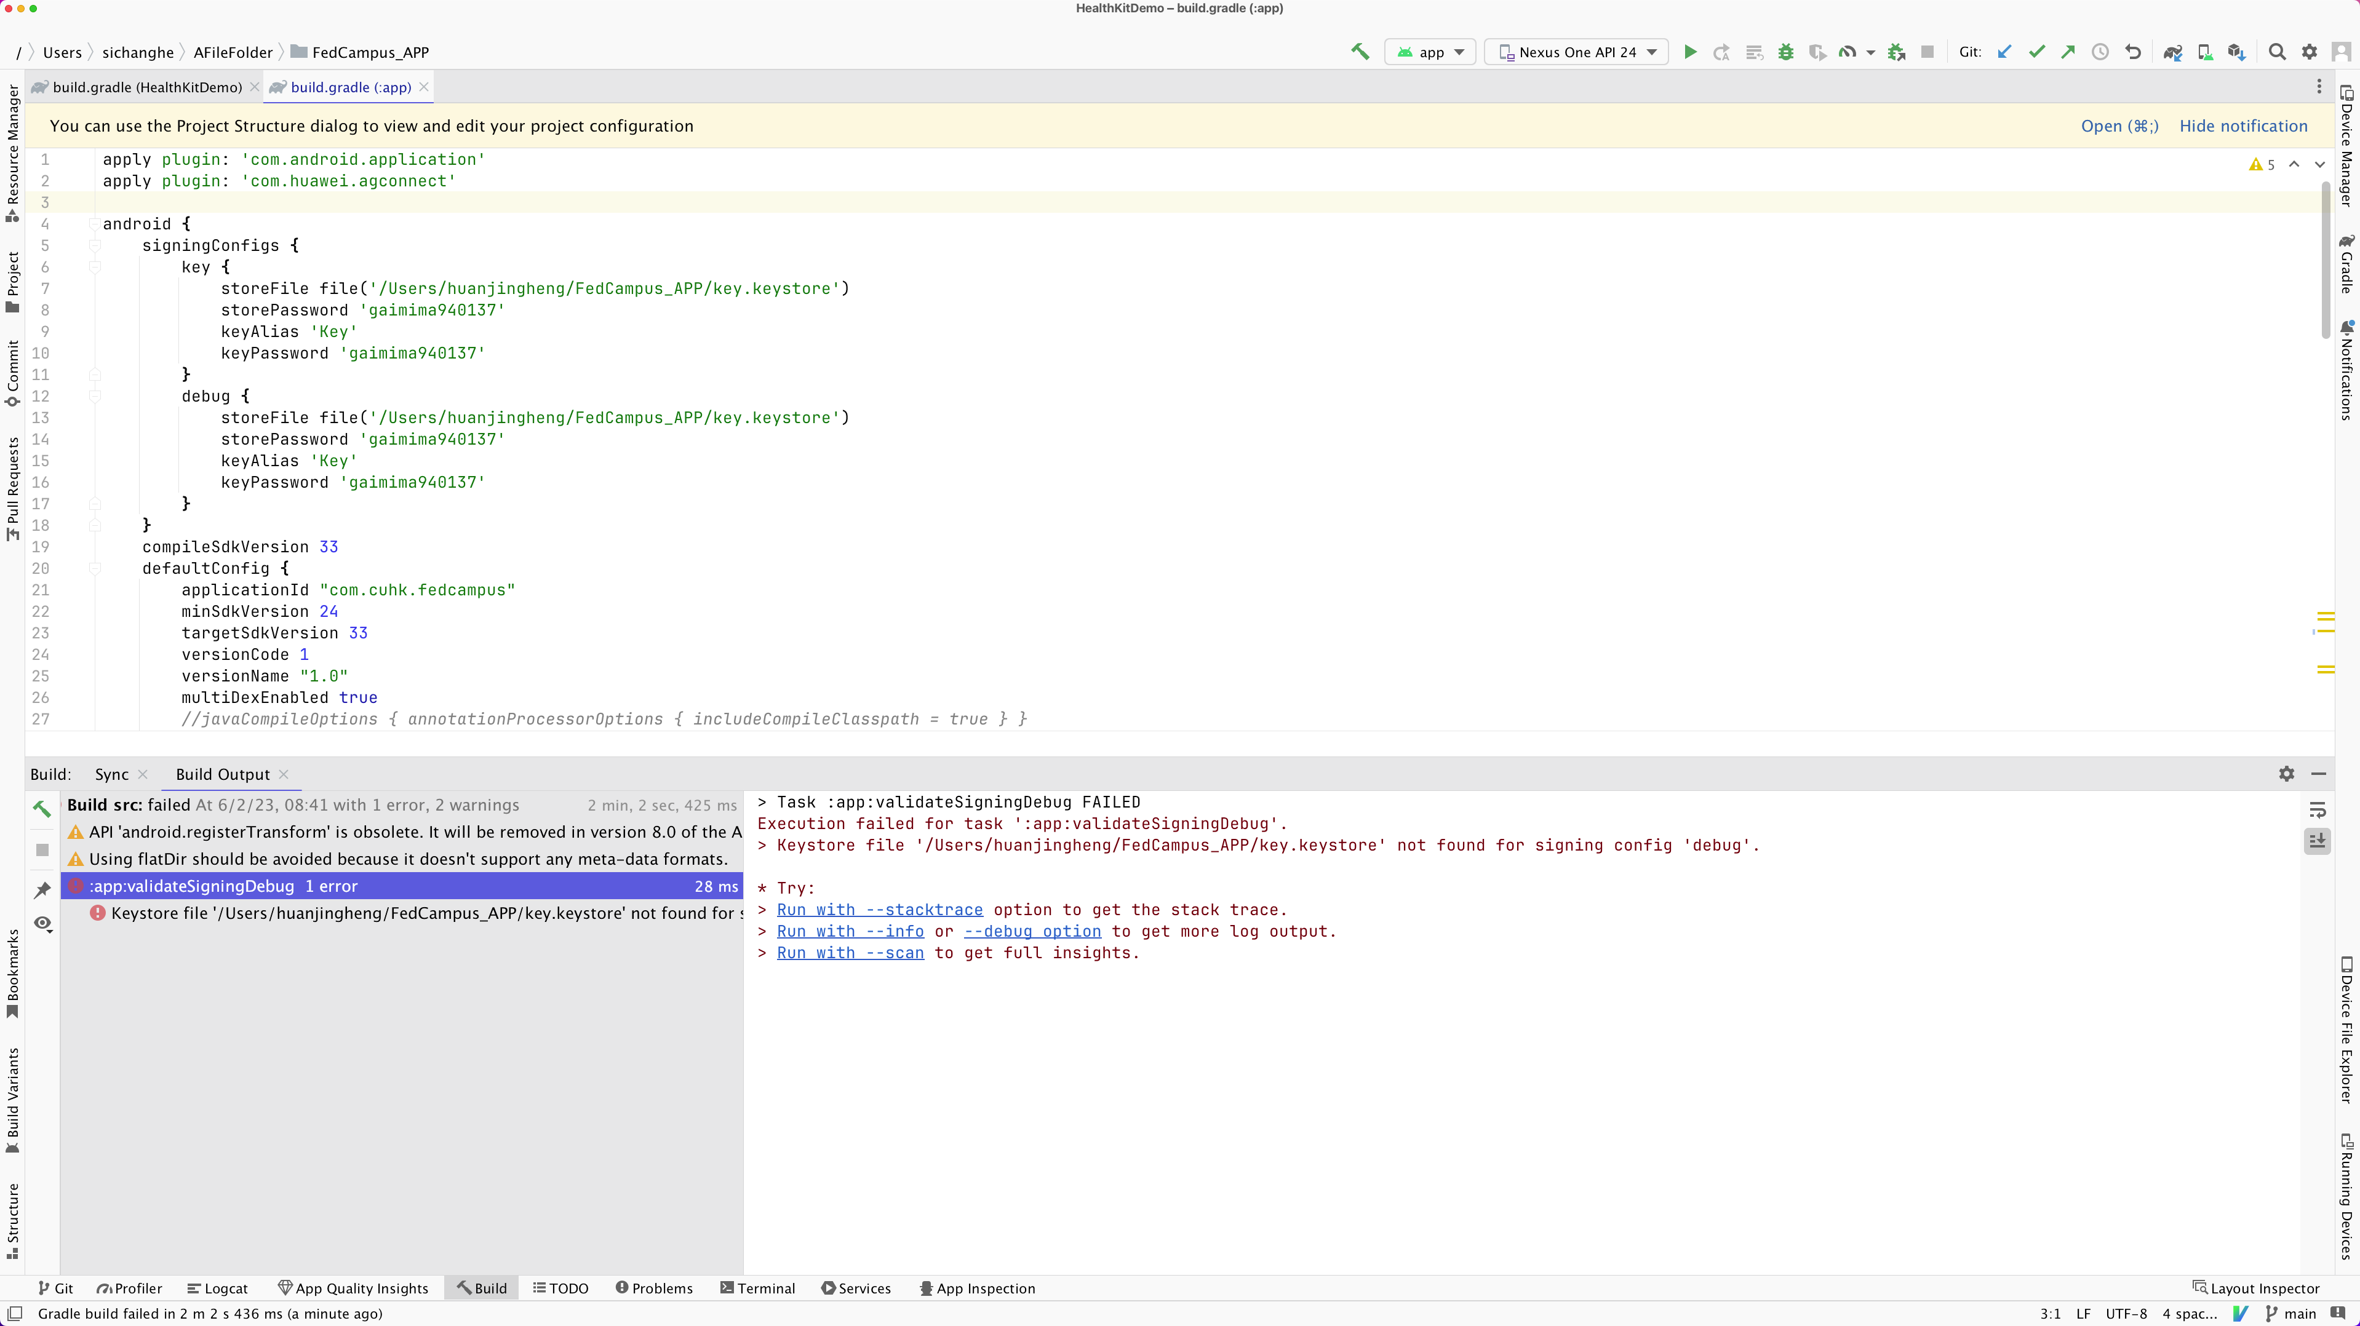
Difficulties that I have
Android App (Beilong)

Slide 16
What I am going to do next week
FedML
Build our own application (FedCV) – how to add our own model, How to Add More Datasets, Domain-Specific Splits & Non-I.I.D.ness Generation Mechanisms?
Run FedML with interactive mode in Docker
Run the interpreter in Visual Studio using Docker environment

Slide 17
What I am going to do next week
Flower
Run Federated Learning on Android Devices in Flower server
Set up backend server dyn_flower_android_drf/backend at main · FedCampus/dyn_flower_android_drf (github.com)
Set up the Android client FedCampus/dyn_flower_android_drf: Dynamic Flower model use on Android by wrapping Flower with Django REST Framework (github.com)
Android App
Eliminate remaining warnings

Slide 18
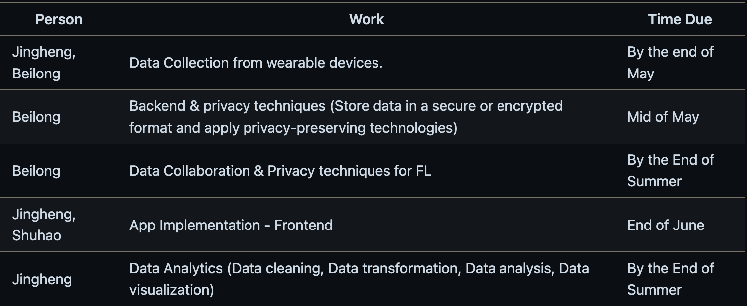
Timeline of the summer

